Slide 1
A ML-based Progress Coordinate for Enhanced Molecular Simulations
09-615 Final Project | 08Dec2022
Darian Yang

Slide 2
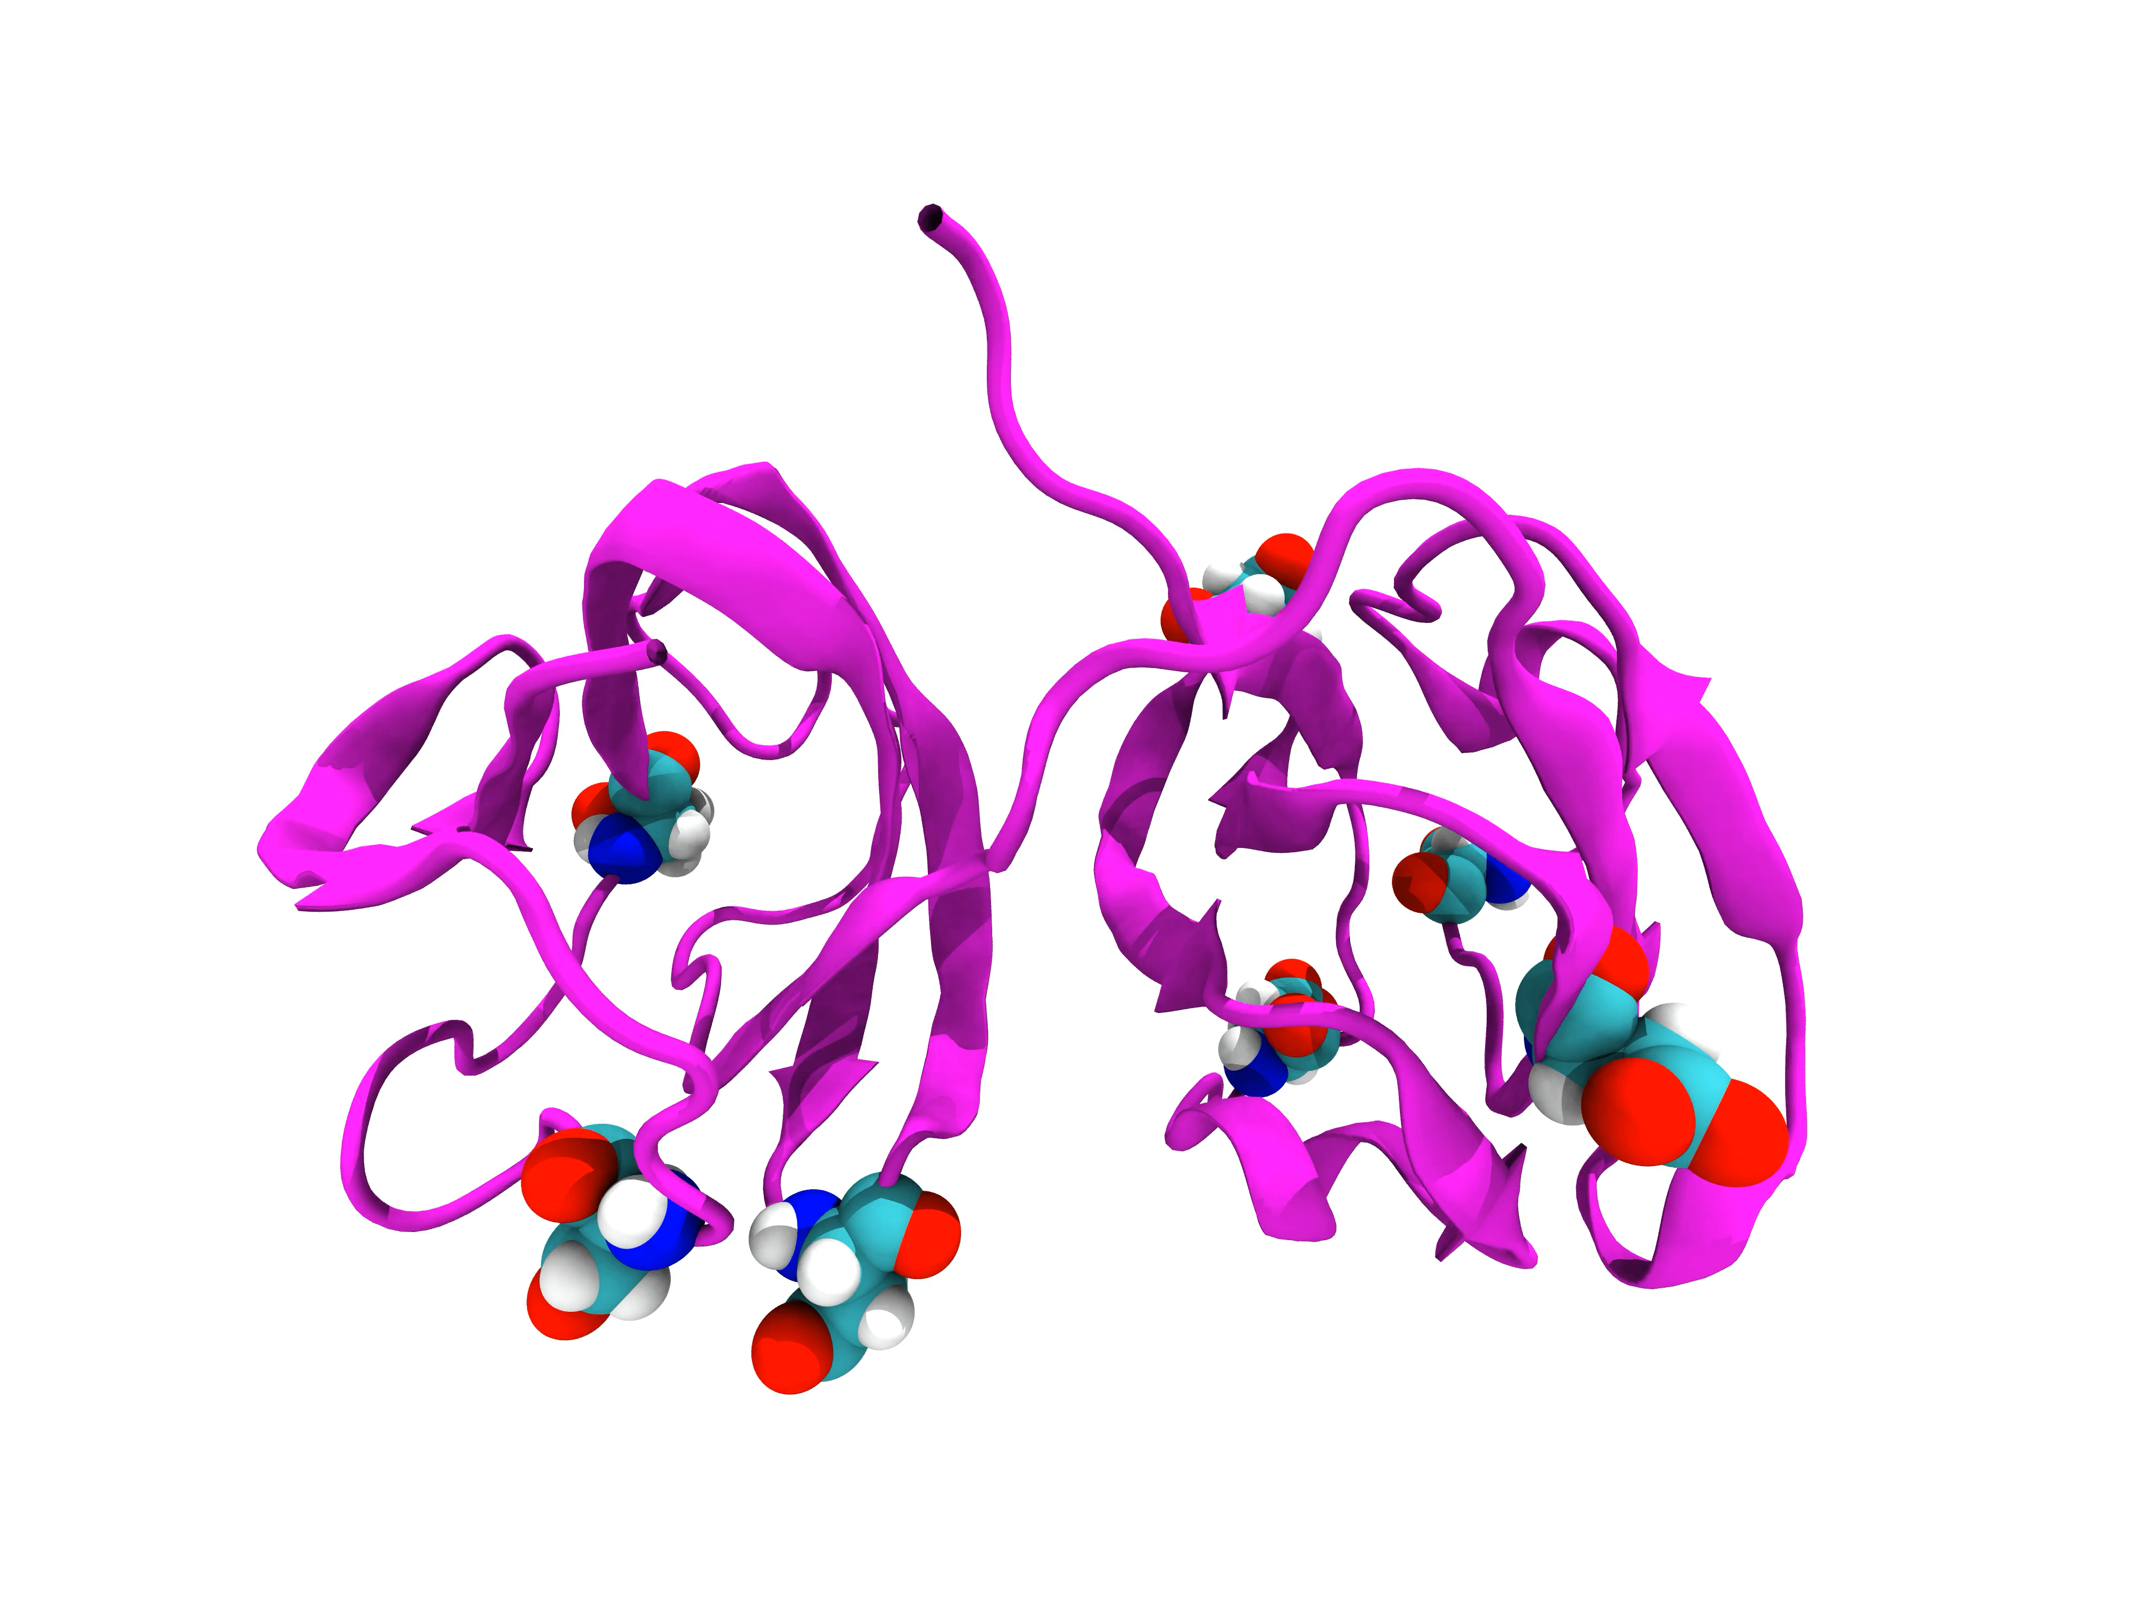
Simulation Timescales are Limited
Anton/GPUs
Loop motions
Protein folding
Surface
side chain
rotation
Buried
side chain
rotation
Loop
formation
Large-scale conformational changes
Bond vibration
Hinge bending
10⁻¹⁵
(fs)
10⁻¹²
(ps)
10⁻⁹
(ns)
10⁻⁶
(μs)
10⁻³
(ms)
10⁰
(s)
Enhanced Sampling
Notes:
Simulation timescales are too slow
Can be solved with path sampling algorithms
Most path sampling requires a “progress coordinate” to sample along
Results are highly dependent on this non-obvious choice
Let’s optimize the progress coordinate choice process with machine learning

Slide 3
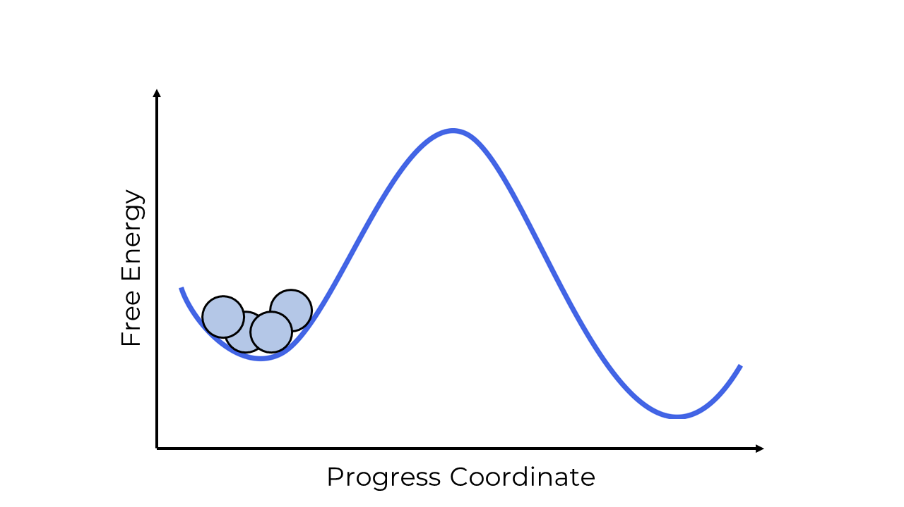
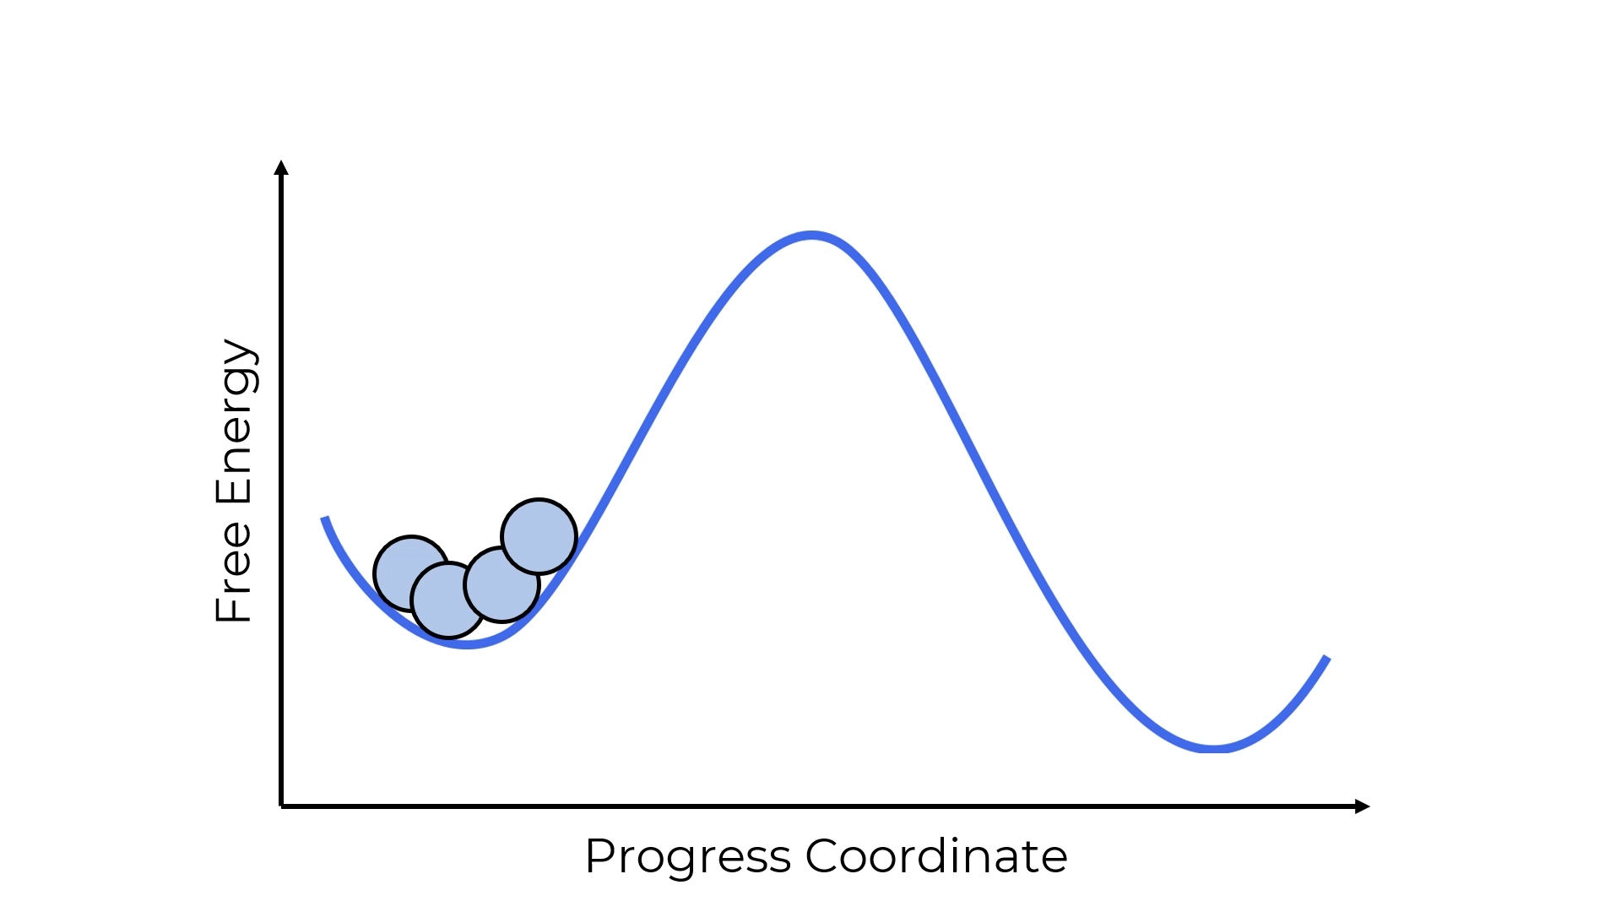
A Splitting Approach to Enhance Sampling
Standard Simulation
Weighted Ensemble
Huber and Kim, Biophys. Journal (1996)
Zuckerman and Chong, Ann. Rev. Biophys. (2017)

Slide 4
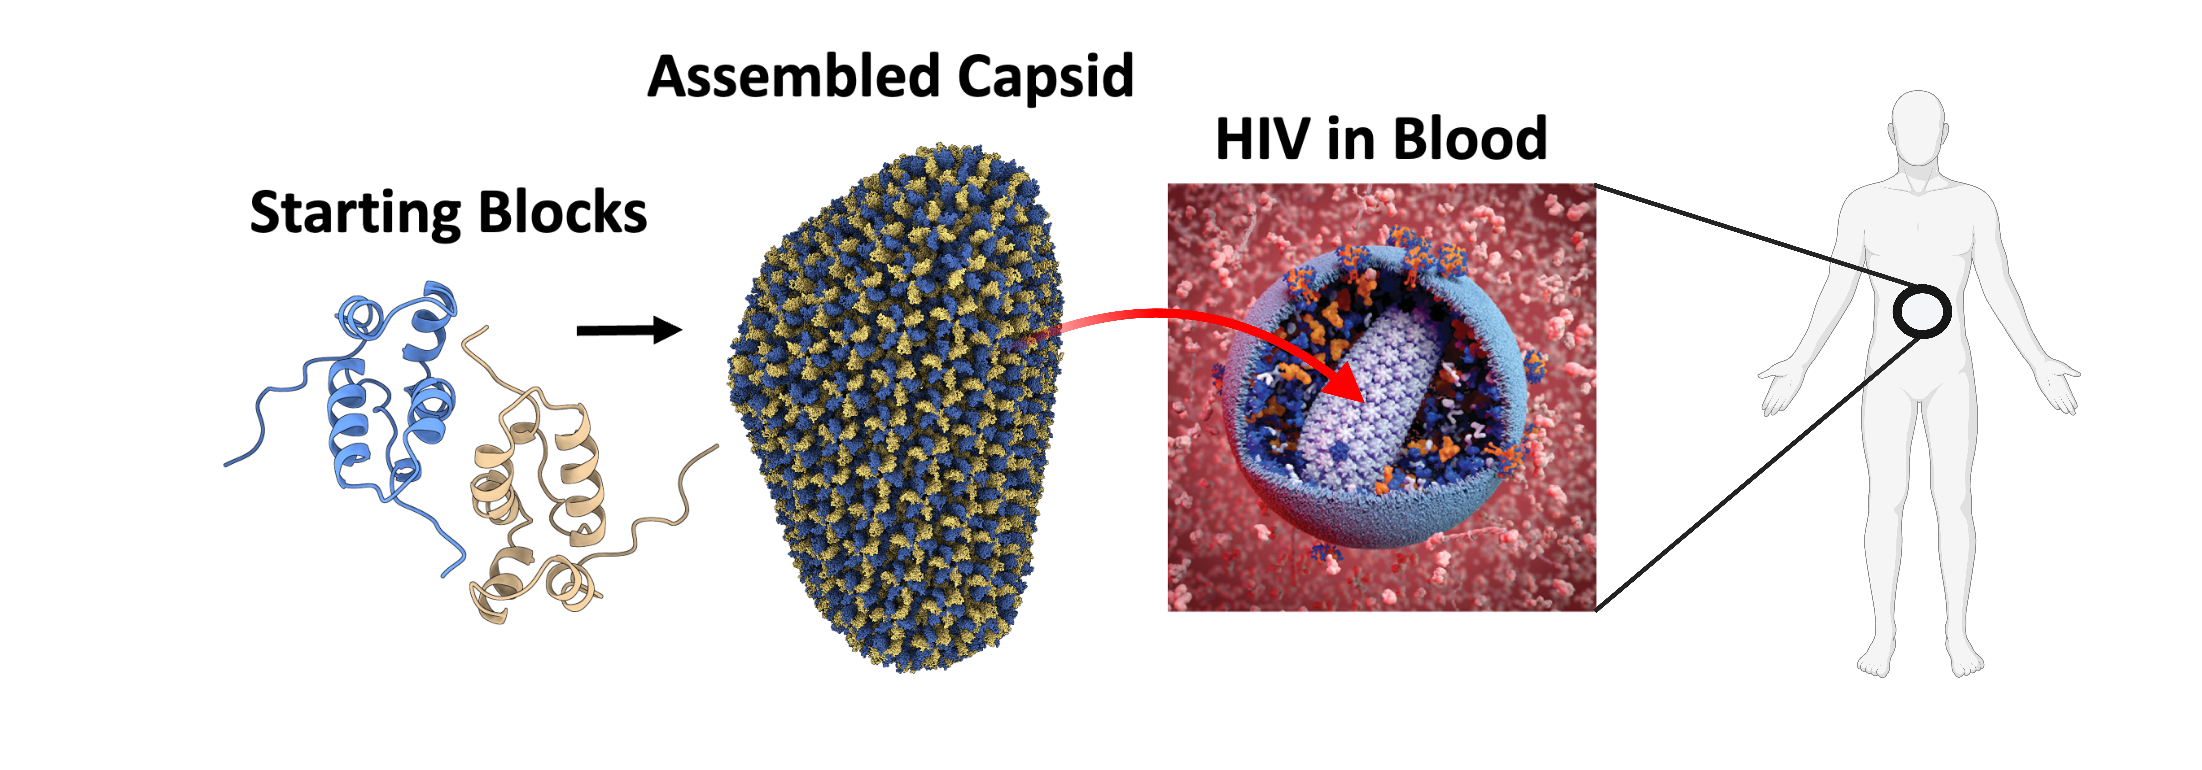
Test System: Human Immunodeficiency Virus 1 (HIV-1) Capsid Protein
Notes:
After 8-10 years of HIV infection, CD4 lymphocyte cell count usually falls low enough to progress into AIDS

Slide 5
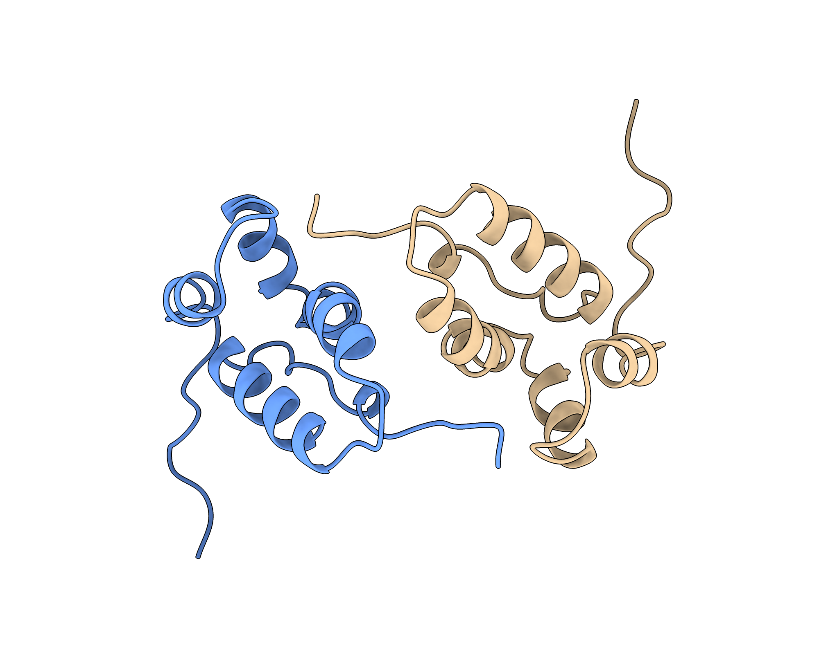
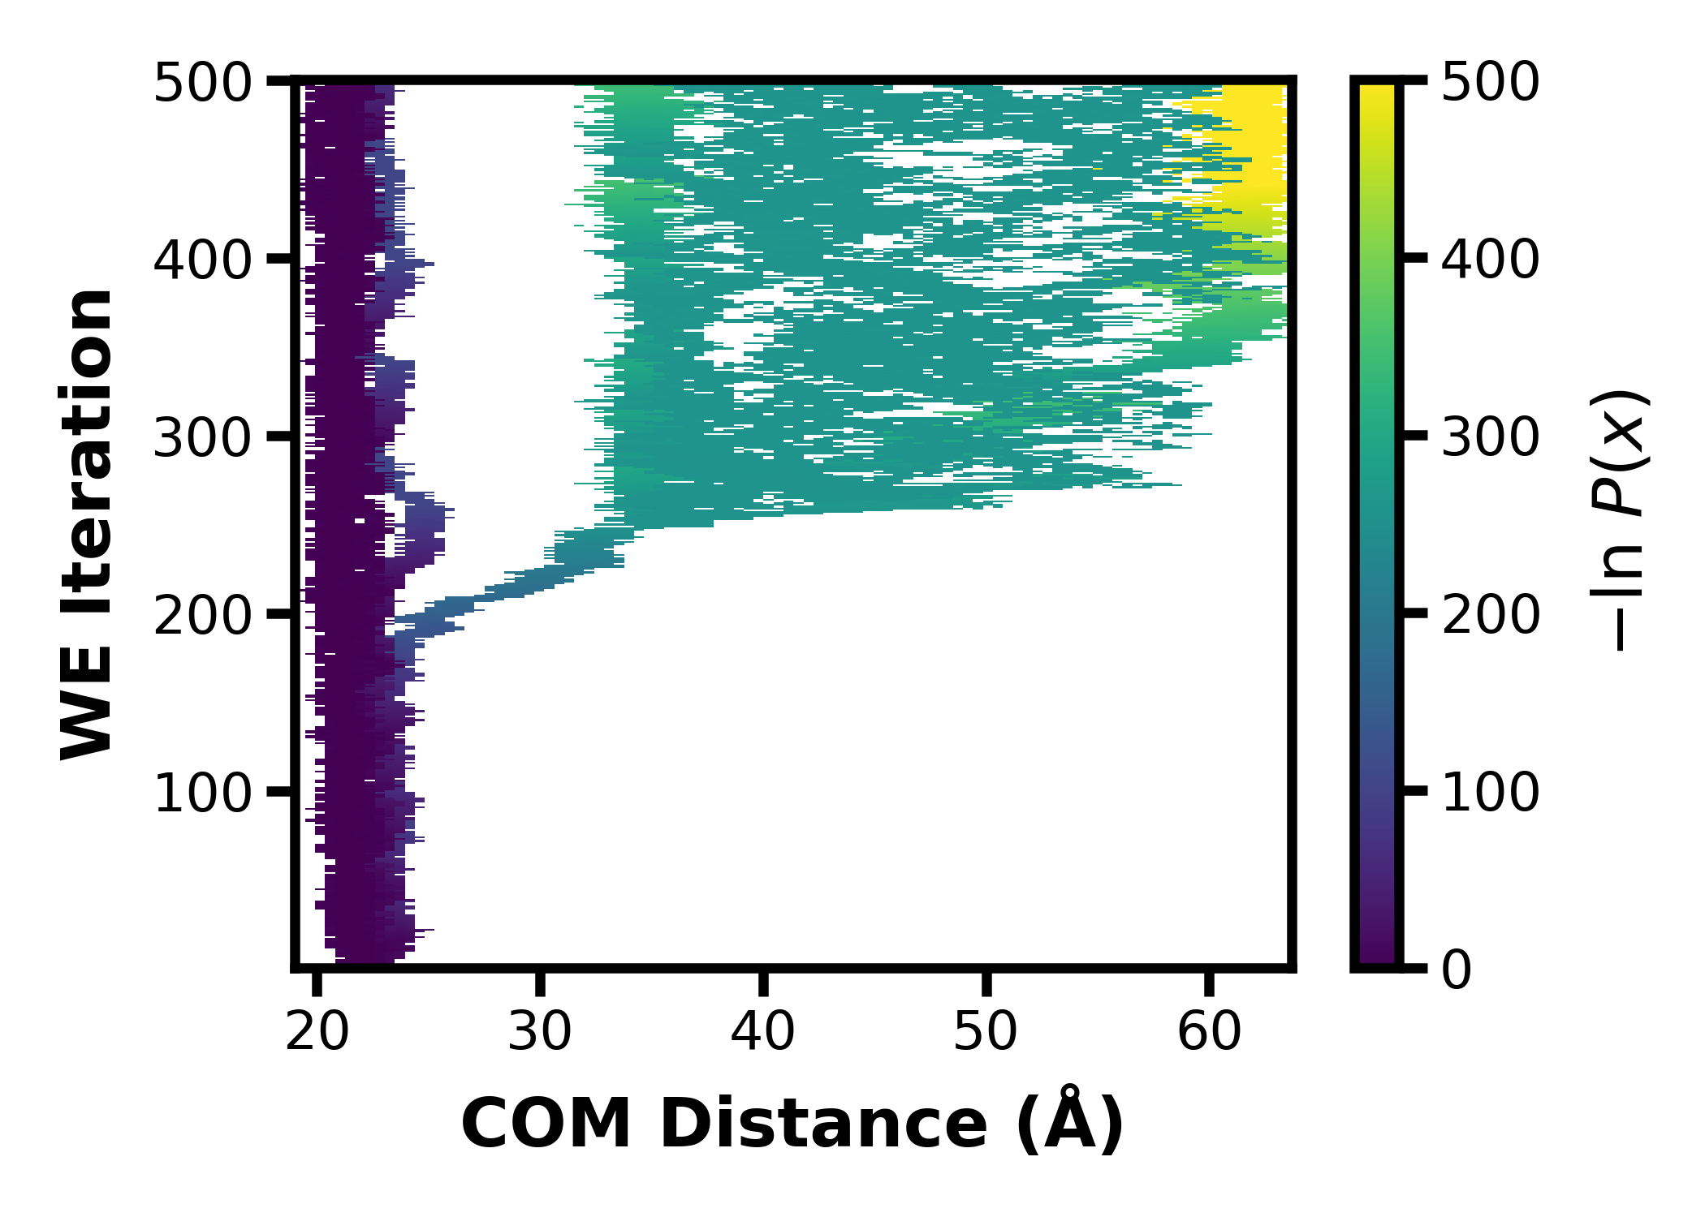
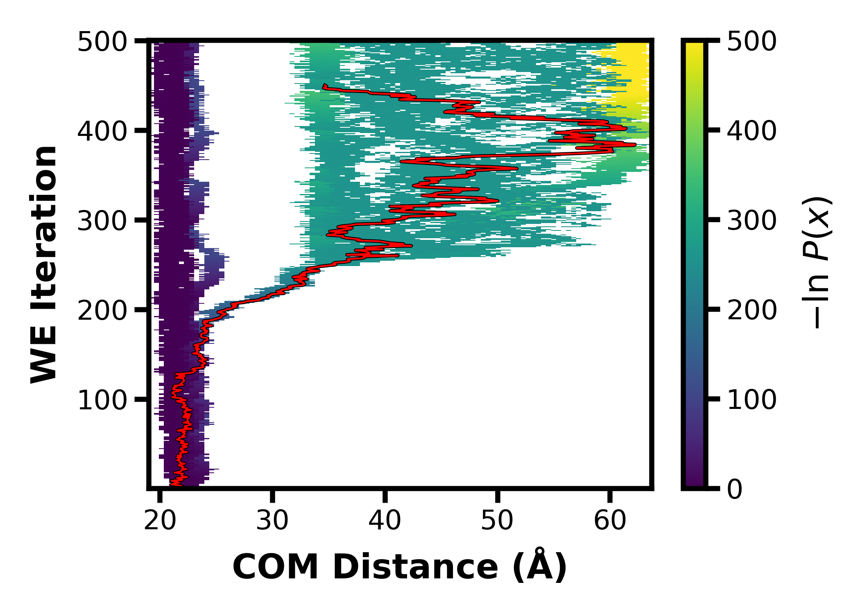
Dataset Curation

Slide 6

Exploratory Data Analysis and Processing
Original Dataset:
17912 simulation trajectories with 100 frames each
Processed Dataset:
50 Columns = Calculated 50 features
Various distances, angles, etc.
|last – first frame| at every iteration (then scaled)
17912 Rows = each short trajectory (10 true)

Slide 7
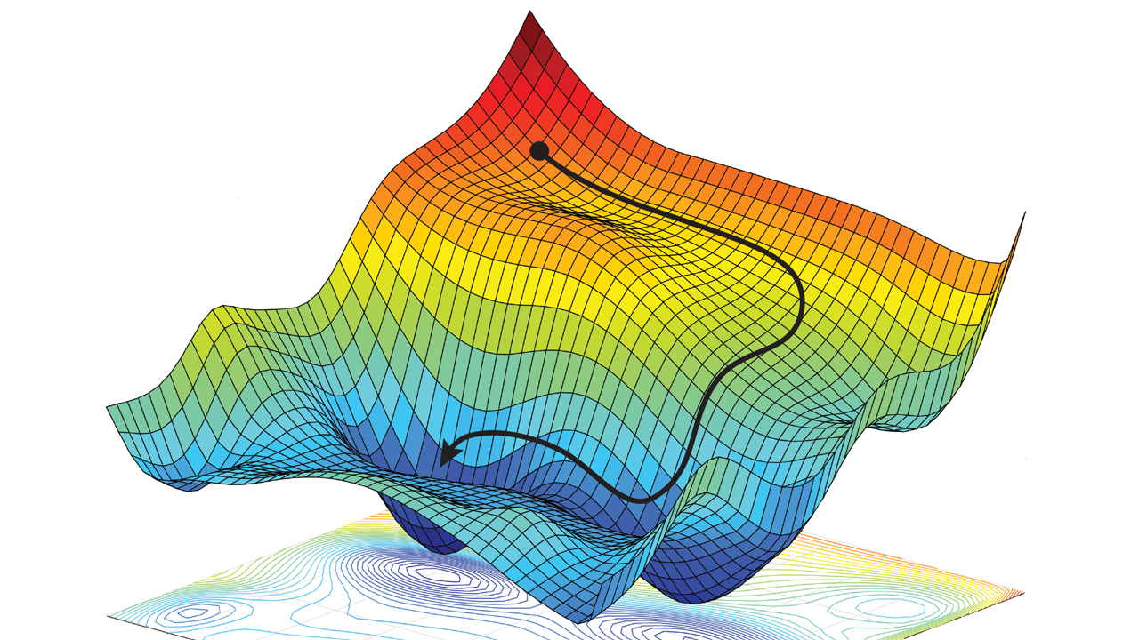
A ML-based Progress Coordinate
Optimization of feature weights
Loss function : ROCAUC score
Output is weights for each feature
New progress coordinate:
Linear combination of weighted features
Notes:
Use local derivative/gradient and go against it, step in –gradient direction to minimize and go down the slope

Slide 8
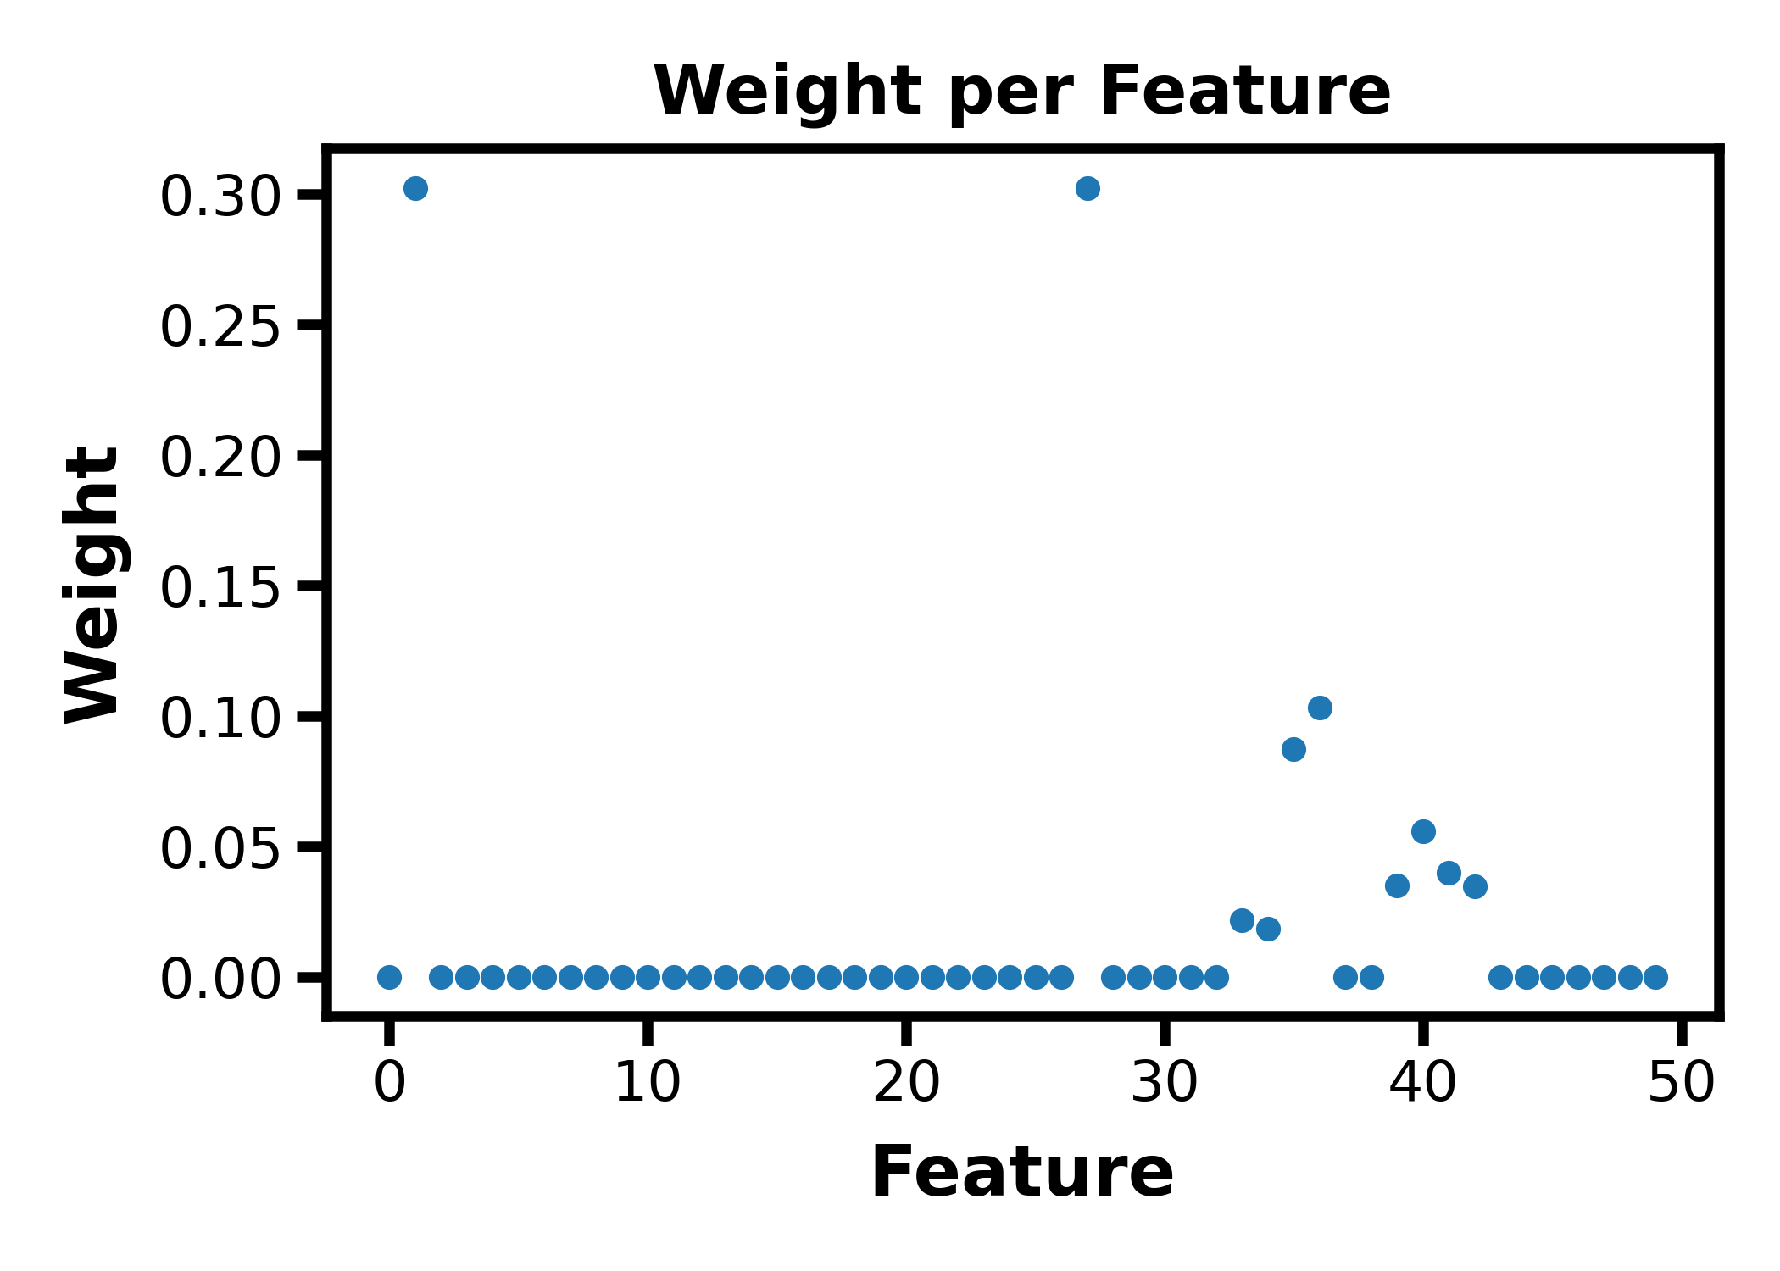
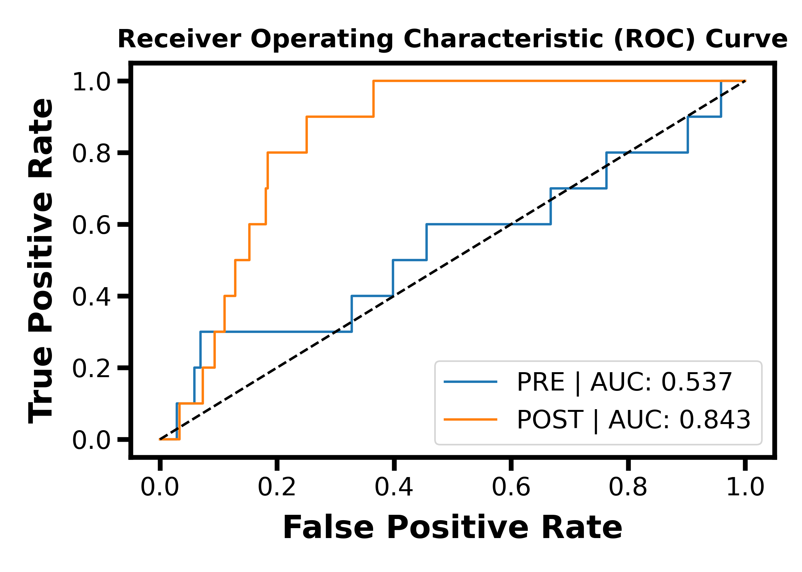
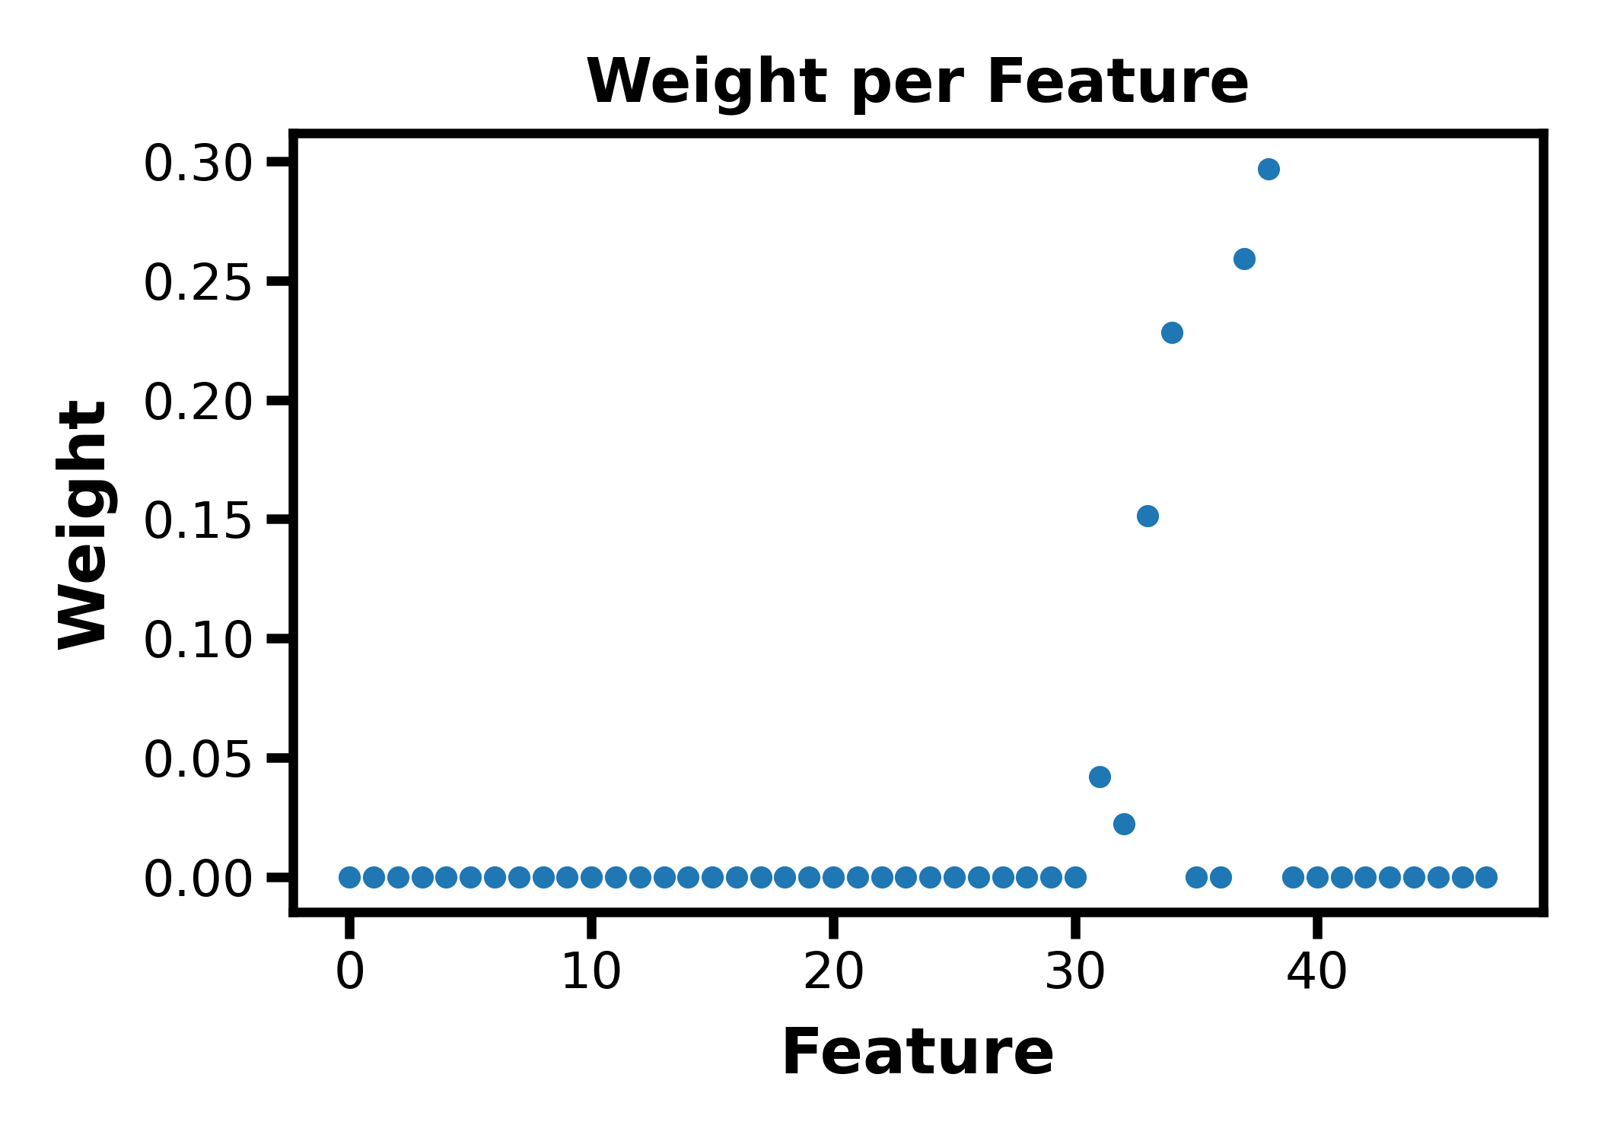
Optimization results
Notes:
Distributions of TP TN where overlap is FP and FN
[('rms_key_int_xtal', 0.24503057930620611), ('rms_key_int_nmr', 0.22379708303092655), ('rms_h9m2_xtal', 0.1761878957847454), ('rms_h9m2_nmr', 0.1275167980732465), ('rms_h9m1_nmr', 0.09171399005671745), ('rms_h9m1_xtal', 0.06397292253096244), ('rms_heavy_nmr', 0.047228119700897415), ('rms_m1_xtal', 0.02419826721935193), ('rms_m1_nmr', 0.00035434429700459305), ('rms_184_185', 1.1490548160995212e-14)]

Slide 9
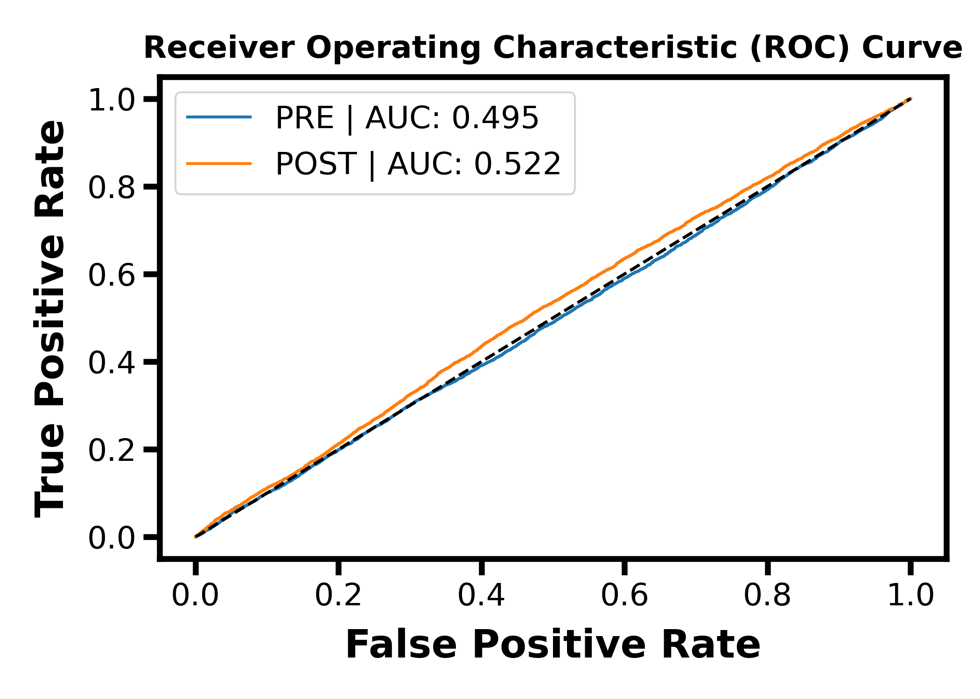
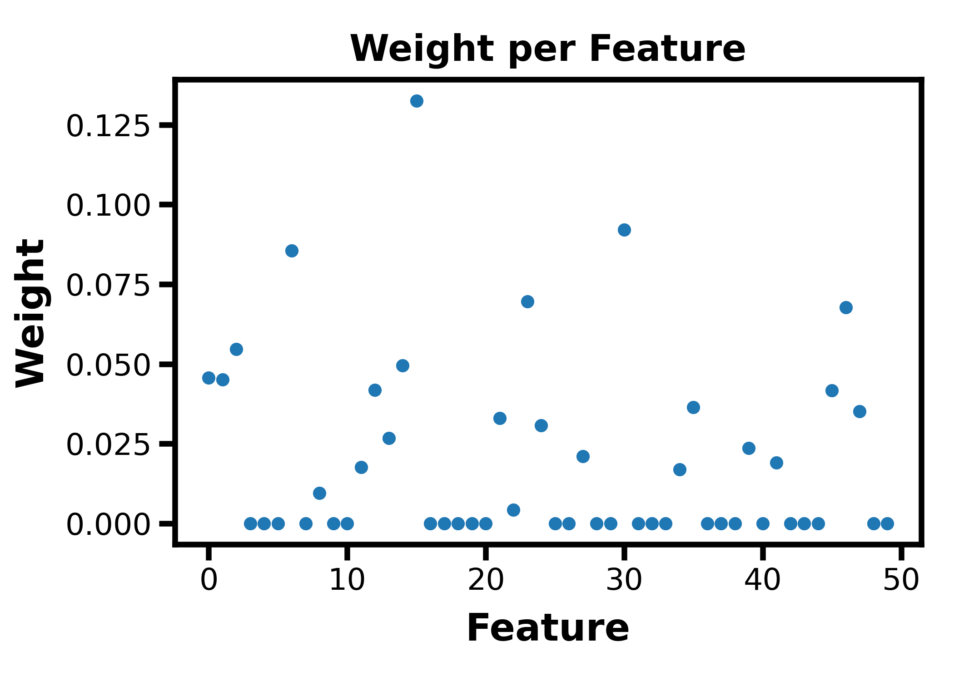
Optimization results (random)

Slide 10
Next steps:
Improve/change loss function or scoring metric
Larger and more diverse input dataset
Or change how ML input array is created
Adding history of trajectory for success labeling
Testing the optimized progress coordinate in a follow-up simulation

Slide 12
A Splitting-based Enhanced Sampling Algorithm
kT
Progress Coordinate (Distance/Angle/etc.)

Slide 13
A Splitting-based Enhanced Sampling Algorithm
kT
Progress Coordinate (Distance/Angle/etc.)

Slide 14
A Splitting-based Enhanced Sampling Algorithm
kT
Progress Coordinate (Distance/Angle/etc.)

Slide 15
A Splitting-based Enhanced Sampling Algorithm
kT
Progress Coordinate (Distance/Angle/etc.)

